Slide 1


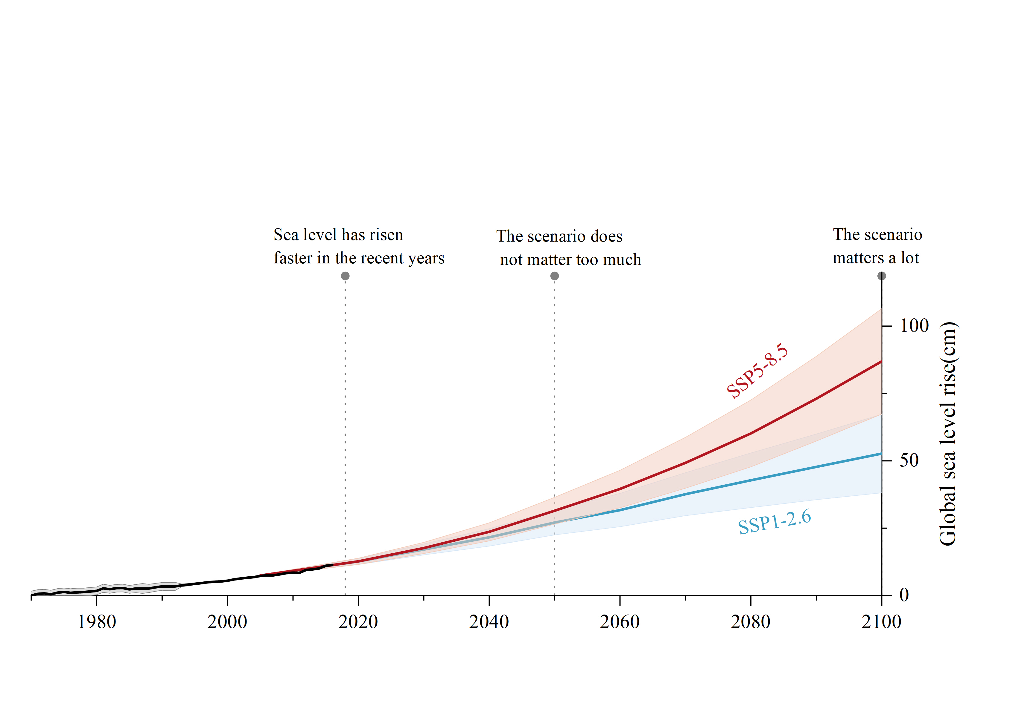

In 2018
In 2050
In 2100
Very high-emission scenario - SSP5-8.5
Observations
Low-emission scenario - SSP1-2.6
Antarctic ice sheet
Greenland ice sheet
Glaciers
Ocean thermal expansion
Water stored on land

Slide 2
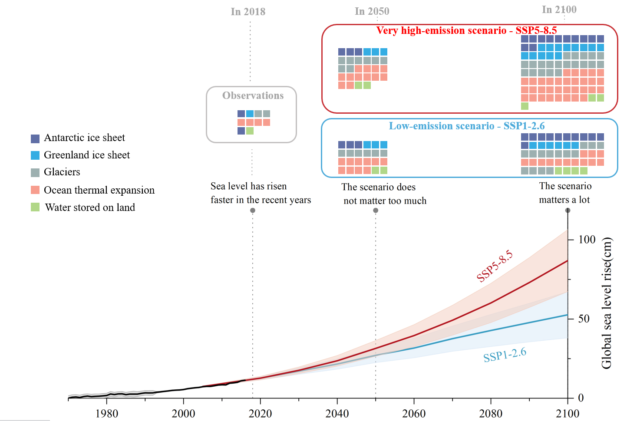
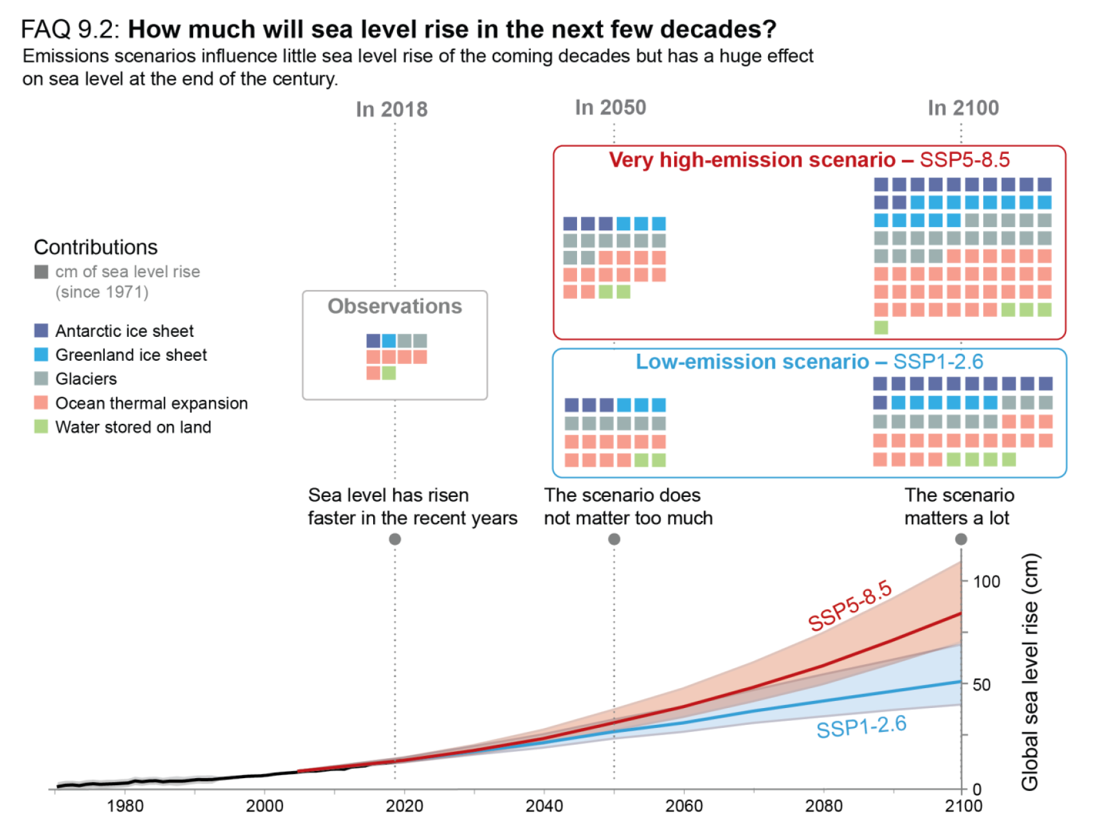

Python/Origin + PPT复现
IPCC原图

